Slide 1
IRIS CLASSIFIER
Ml INTERMEDIATE Term3 Project
By: Raj gupta (Aug cohort batch)

Slide 2
Problem statement
Task is to build a model to predict the Species of a flower and classify it
Best known database to be found in the pattern recognition literature.
The data set contains 3 classes of 50 instances each, where each class refers to a type of iris plant.
One class is linearly separable from the other 2, the latter are NOT linearly separable from each other.
Predicted attribute is class of iris plant

Slide 3
Data description
Dataset includes three iris species with 50 samples each as well as some properties about each flower. One flower species is linearly separable from the other two, but the other two are not linearly separable from each other.
This dataset contains measurements of flower petals and sepals and has corresponding labels to one of the three classes
The columns in this dataset are:
Id
SepalLengthCm
SepalWidthCm
PetalLengthCm
PetalWidthCm
Species
Species of a flower can be of three types:
Iris-setosa
Iris-versicolor
Iris-virginica

Slide 4
missing data imputation
There is no missing value in the dataset
Each column contains 150 sample values

Slide 5
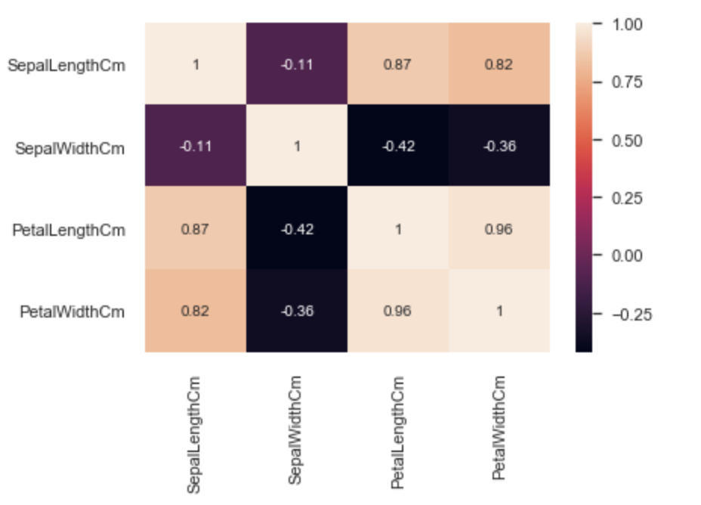
Correlation using heatmap

Slide 6
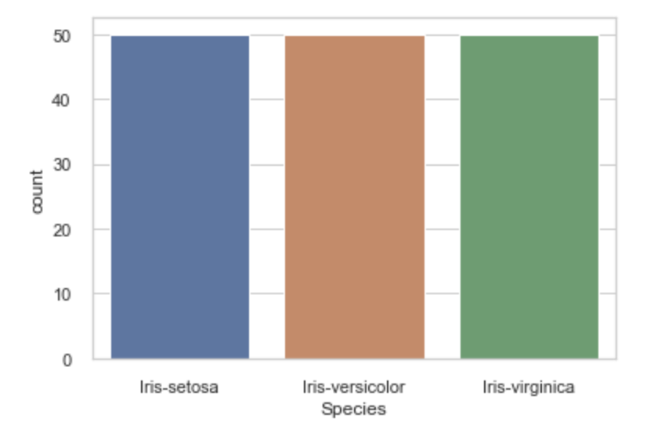
target variable - “SPECIES”
The Species column data is equally divided into 3 classes and having 50 samples of each class.

Slide 7
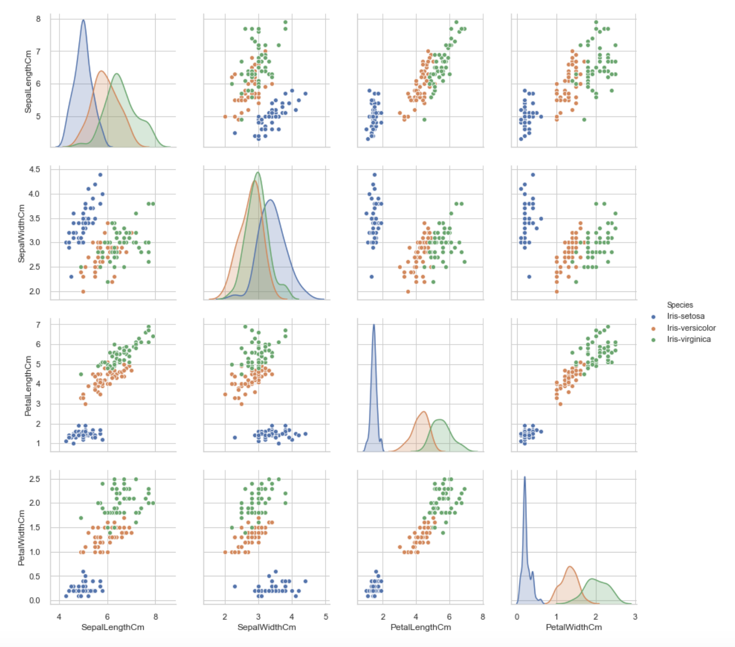
Scatter plot

Slide 8
EDA
It is a balanced dataset as it includes three iris species with 50 samples each.
There is no missing value in the dataset.
From Correlation Heatmap,
PetalLengnthCm and PetalWidthCm are positively correlated
PetalWidthCm and SepalLengthCm are positively correlated
SepalLengthCm and PetalLengnthCm are positively corelated
As per SepalLengthCm and SepalWidthCm scatterplot,
Setosa flowers can be easily distinguished from others
It is difficult to differentiate Versicolor from Viginica as they have considerable overlap
As per PetalLengthCm and PetalWidthCm scatterplot,
All the three flower species can be differentiated

Slide 9
model building
Since target variable is a Categorical variable with 3 classes, it is a multi class classification problem.
ML algorithms used for model building are:
Logistic Regression
Decision Tree
Random Forest
KNN
Naïve Bayes
Support Vector Machine
Neural Network

Slide 10
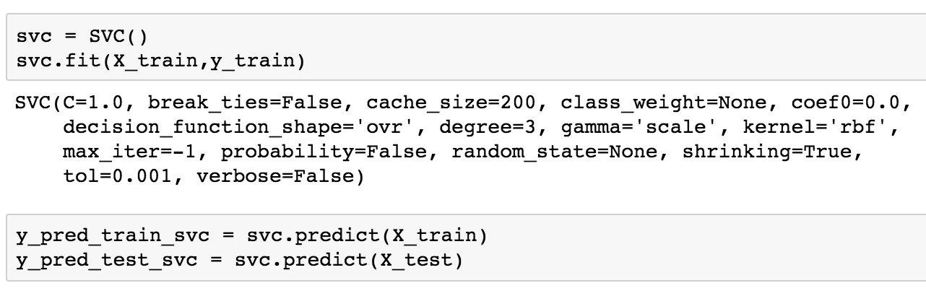
Support Vector Classifier

Slide 11
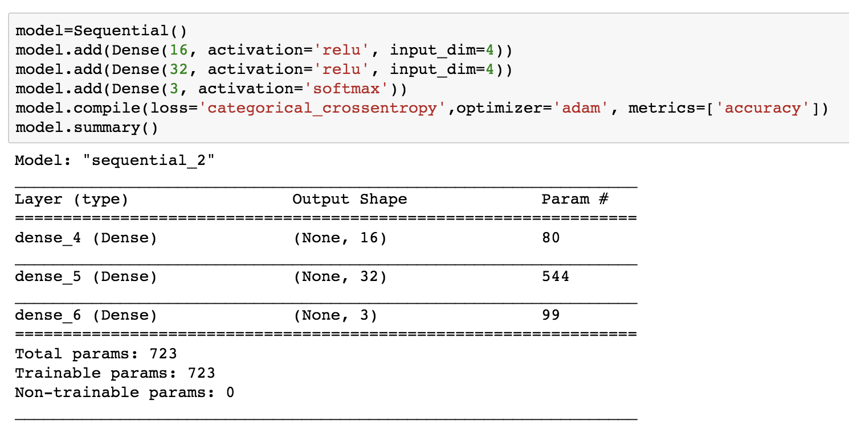
Neural network

Slide 12
Model evaluation
For a classification problem, we will evaluate the models based on:
Confusion Matrix
Accuracy Score
Precision
Recall
F1 score

Slide 13
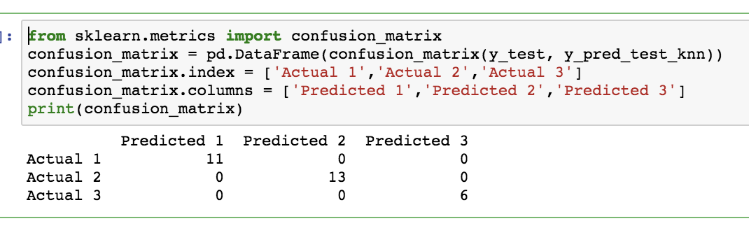
CONFUSION MATRIX of KNN classifier

Slide 14
ACCURACY SCORE
Model Name | Train Accuracy (%) | Test Accuracy (%) | Diff(%)
Logistic Regression | 97.5 | 96.7 | 0.8
Decision Tree | 100 | 96.7 | 3.3
Random Forest | 100 | 96.7 | 3.3
KNN | 95 | 100 | 5
Naïve Bayes | 95 | 96.7 | 1.7
SVC | 96.7 | 96.7 | 0
Neural Network | 99.1 | 96.7 | 2.4

Slide 15
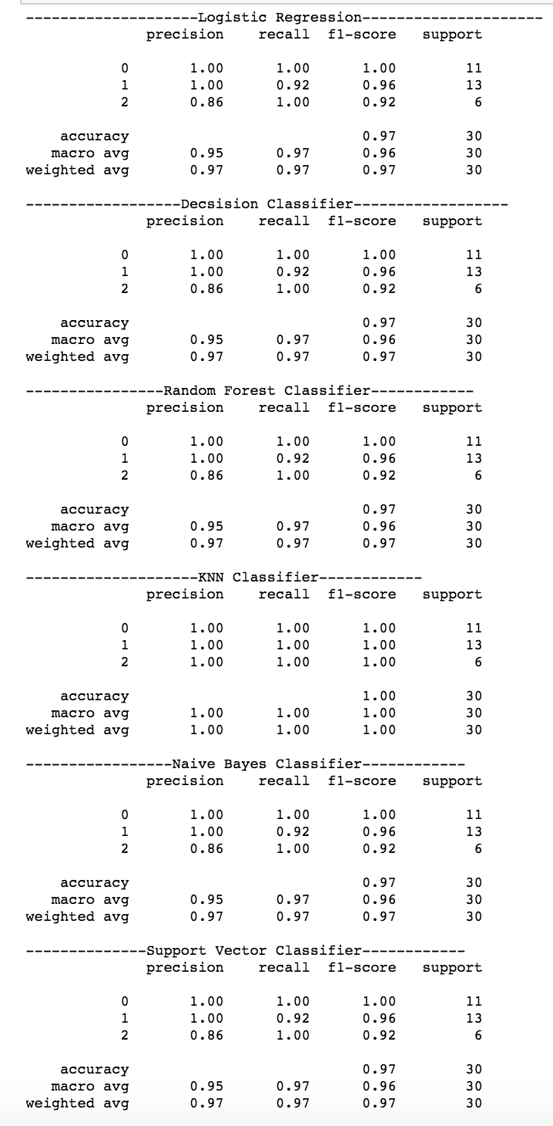
CLASSIFICATION REPORT COMPARISON

Slide 16
conclusion
We have built the model to precisely predict Species of a flower and classify it accordingly.
We have compared the performance of the models using various model evaluation techniques.
Model evaluation step shows SVC model is more suitable for this dataset as it has generalized most with same train and test accuracy score
KNN classifier has shown 100% test accuracy.
Advanced model techniques like neural network is also applied to see if there is any improvement but dataset is very small for this model.

